Slide 1





Why Tier-2 & Tier-3 India is Ripe for Disruption
Macro Trends
Underserved Sectors
Healthcare
Economic Power
Critical infrastructure gaps
Tier-2/3 cities contribute ~45% of India's GDP by 2025
Education
Quality access barriers
Population Scale
Finance
650M people across Tier-2/3 markets
Limited banking reach
Digital Adoption
Agriculture
60% smartphone penetration vs 78% urban
Technology adoption lag
Payment Revolution
UPI >12B transactions/month by 2025
Urban
Tier-2/3
Digital readiness + structural gaps = fertile ground for disruption

Slide 2



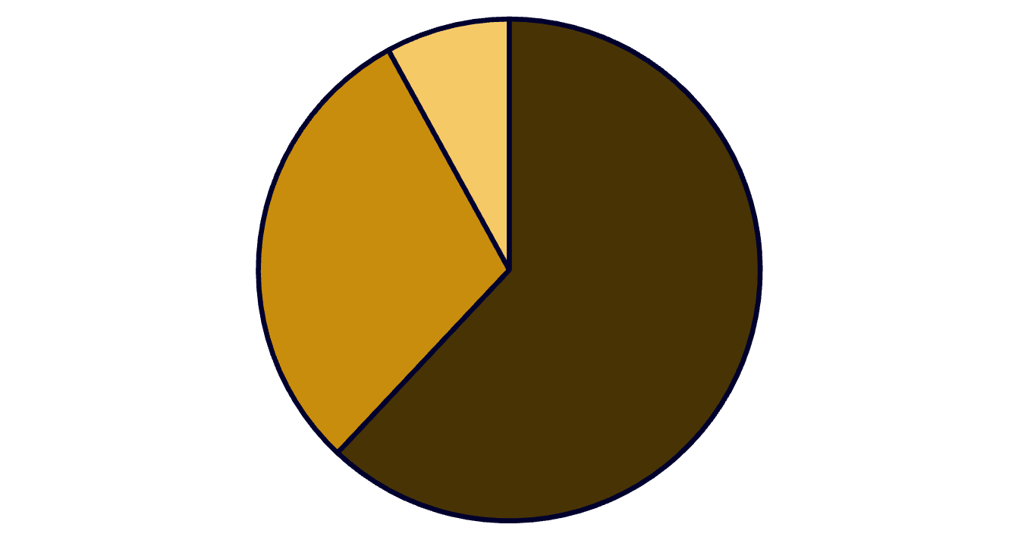

Healthcare in Tier-2/3 India: Urgent Problem, Large Market
Accessibility Crisis
Affordability Gap
Awareness & Trust
75% doctors in urban areas → 600M underserved. Average 50+ km travel for specialist care.
Out-of-pocket = 62% of healthcare spend. ~60M pushed into poverty yearly.
Preventive care stigma. Heavy reliance on unqualified practitioners.
Market Potential
$372B
Healthcare Market
By 2025 (CAGR 22%)
$5.4B
Telemedicine
By 2025
Out-of-Pocket
Government
Insurance
160M+
eSanjeevani
Teleconsultations
Healthcare = burning platform with unmet need, adoption signals & policy tailwinds

Slide 3





MediChain: Tech-enabled Primary Care & Diagnostics
AI Symptom Triage
IoT Diagnostic Kiosks
Vernacular chatbot for initial assessment. Triage consultations under ₹20.
BP, ECG, SPO₂, blood sugar testing. Kiosk deployment ~₹1L each.
Blockchain Health Records
Phygital Linkages
NDHM aligned, secure, portable patient data management.
Local pharmacy partnerships with last-mile medicine delivery.
Key Differentiators
5-Year Growth Roadmap
Vernacular-first UX
Year 1
1
Local language interface for better accessibility
100 kiosks, 50K users
Affordable Pricing
2
Year 3
<₹100 consults, ₹499 family subscriptions
25 cities, 1M users
Trust Building
Year 5
3
Pharmacy kiosks + NGO/government partnerships
Pan-India, 100M+ lives impacted
650K Population
Target market reach
75K Reach
Initial awareness
50K Active
Regular users
20K Teleconsults
Monthly consultations
5K Paid Subs
Premium subscribers
MediChain = vernacular, trust-first, affordable healthcare pathway for Bharat

